Slide 1
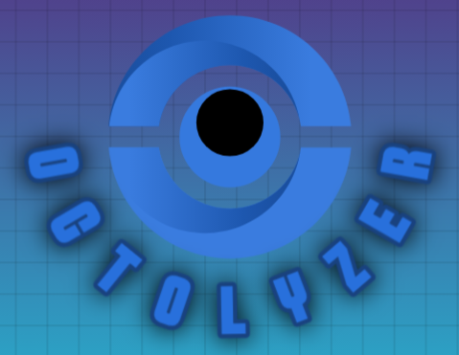



OCTolyzer: fully automatic analysis for scanning laser ophthalmoscopy and optical coherence tomography data
Training session
Jamie Burke
OCTober 2024

Slide 2
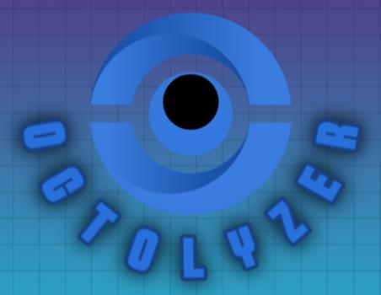
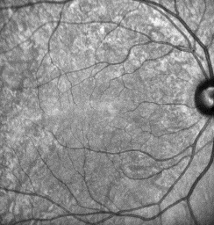
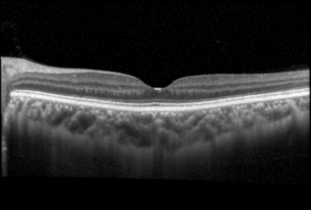
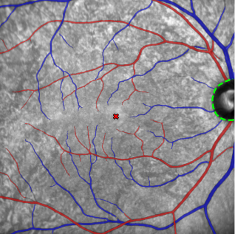
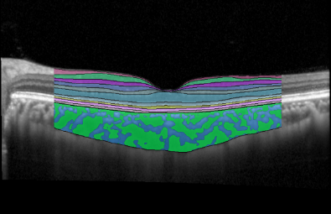
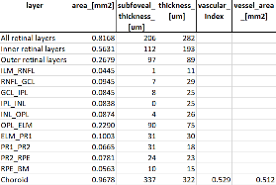
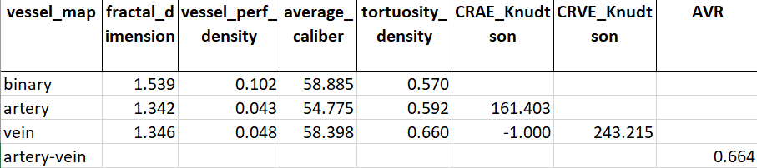
.vol file
OCTolyzer
OCT/SLO Metadata
SLOctolyzer
OCT Analysis Suite
SLO Analysis Suite
Segmentation module
Segmentation module
Measurement module
Measurement module
Complexity, Tortuosity, Calibre
Thickness, Area, Vascularity

Slide 3
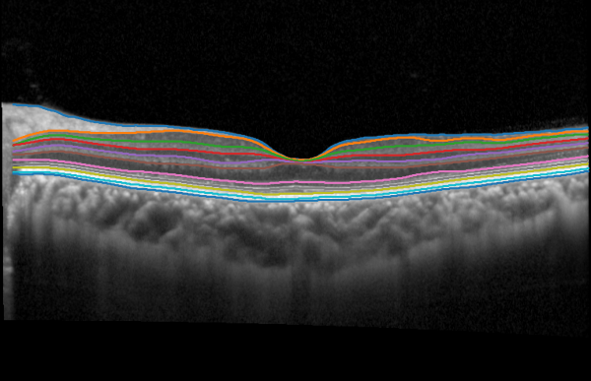
.vol file
OCT/SLO Metadata
Basic demographics: Patient ID, DOB, date/time, …;
Retinal layer segmentations from imaging device;
Pixel length-scales (pixel space -> physical space);
OCT quality index (signal-to-noise ratio);
OCT scan focus (correcting for refractive error);
…

Slide 4
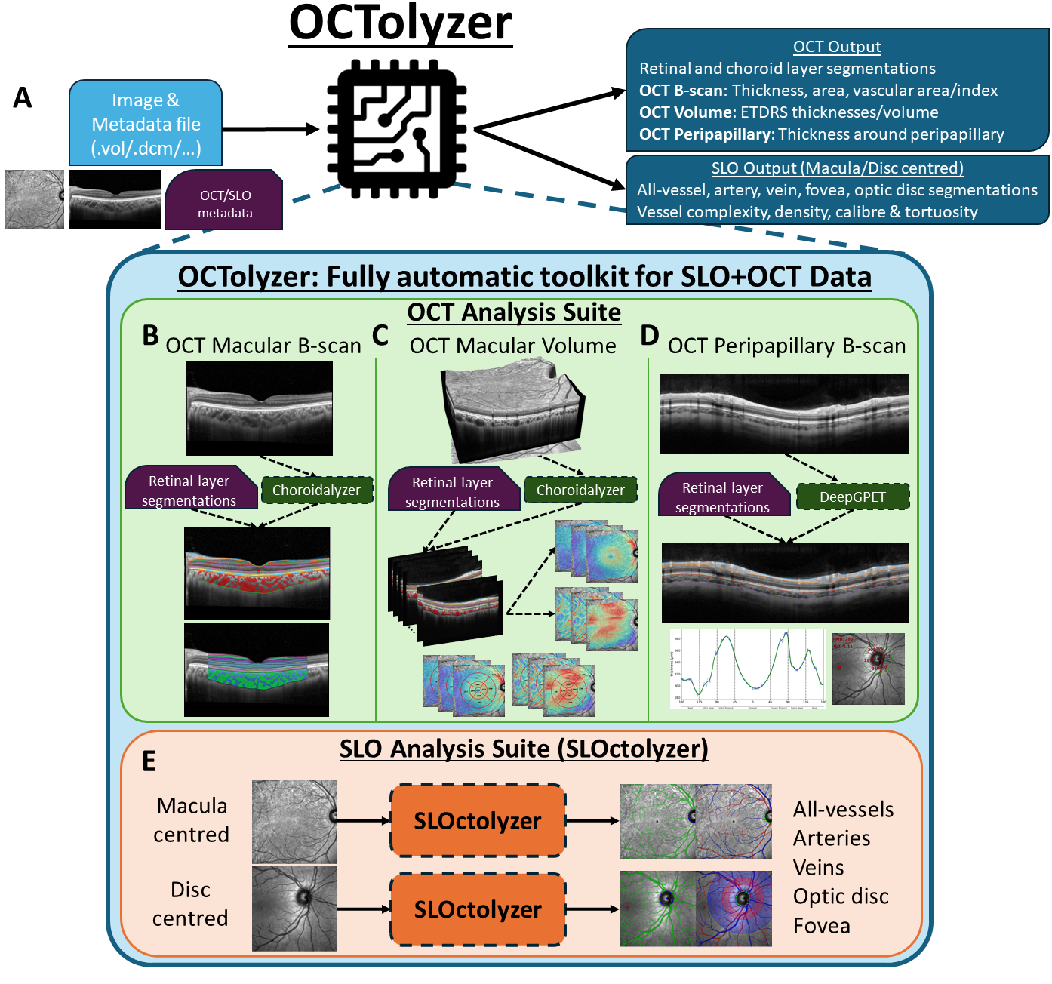
.vol file
OCT/SLO Metadata
Basic demographics: Patient ID, DOB, date/time, …;
Retinal layer segmentations from imaging device;
Pixel length-scales (pixel space -> physical space);
OCT quality index (signal-to-noise ratio);
OCT scan focus (correcting for refractive error);
…

Slide 5

Macular, fovea-centred horizontal/vertical single line scans.

Slide 6
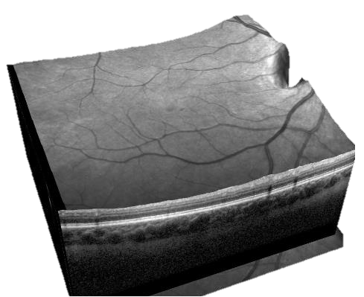
Macular, fovea-centred horizontal/vertical single line scans.
Macular, posterior pole volume scan (multiple, parallel OCT B-scan acquired over macula).

Slide 7
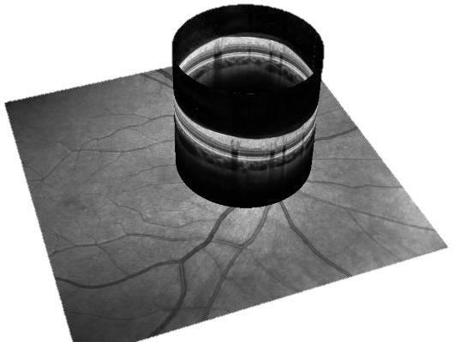
Macular, fovea-centred horizontal/vertical single line scans.
Macular, posterior pole volume scan (multiple, parallel OCT B-scan acquired over macula).
Optic disc-centred, peripapillary OCT circular scan.

Slide 8
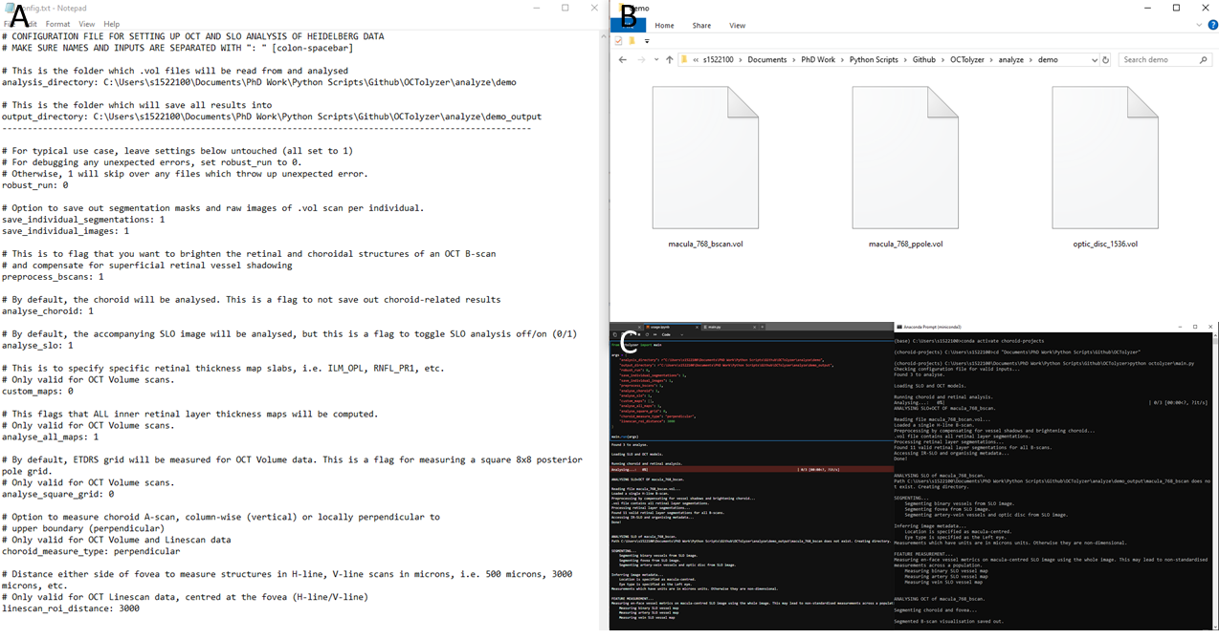
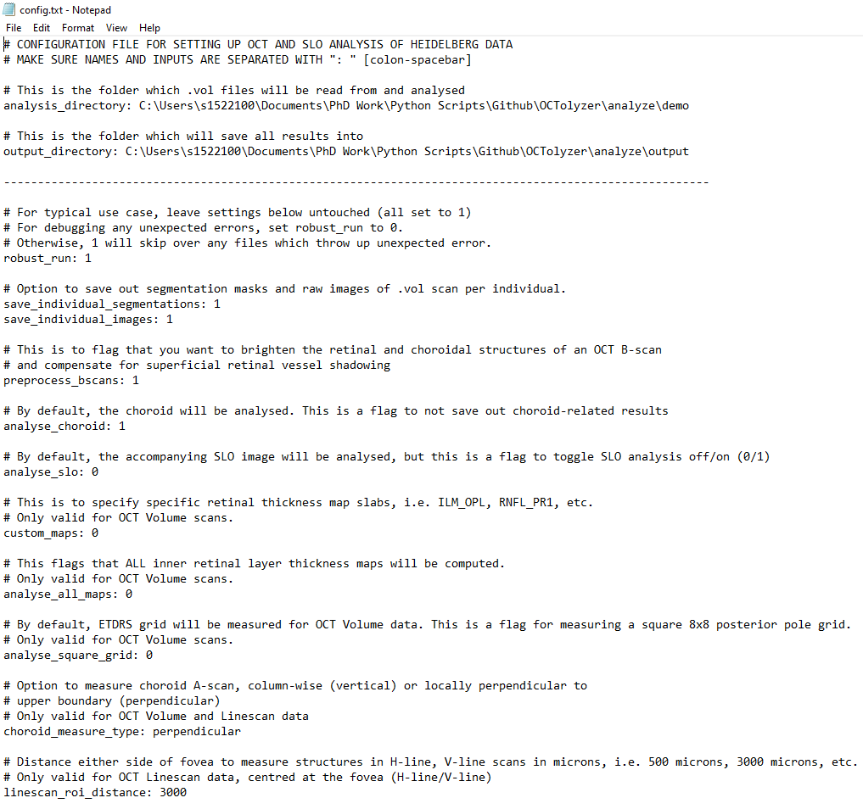
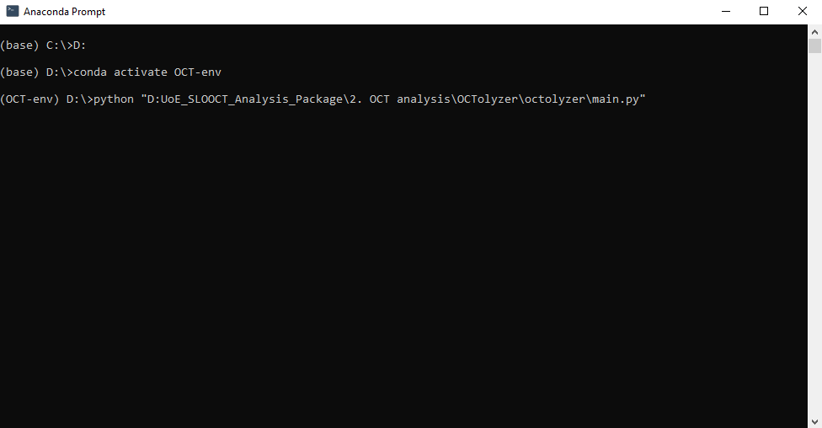
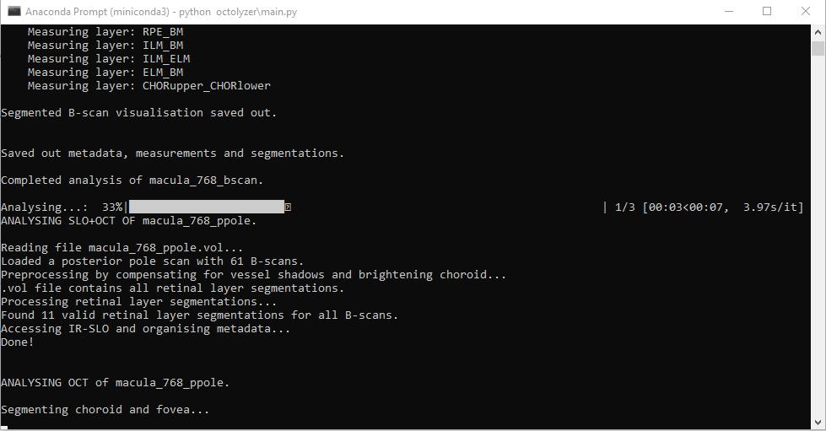
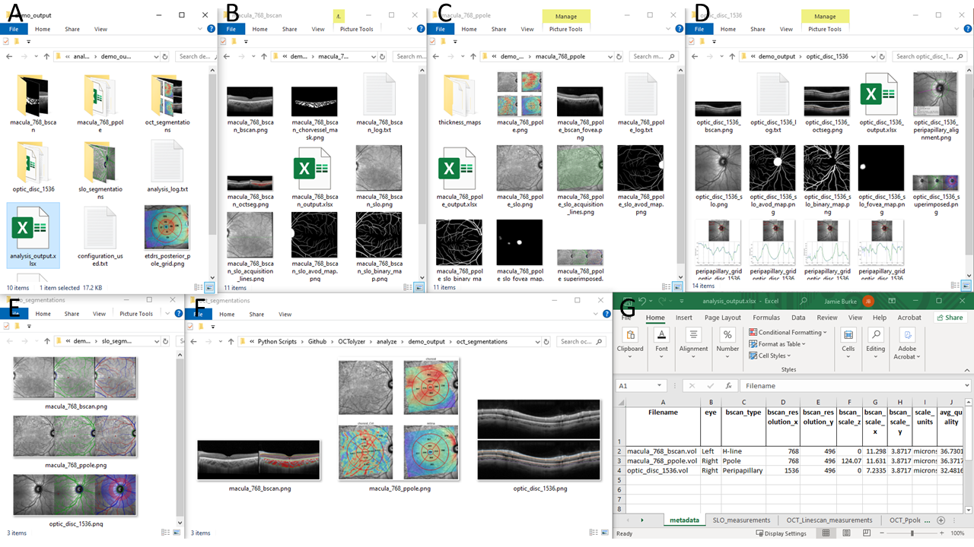
Running OCTolyzer on PC3
Place all .vol files into a single directory.
Set up configuration file with pipeline parameters.
Load Anaconda Prompt and run 3 commands:
Type conda activate oct-analysis and press Enter;
Navigate to OCTolyzer: Type cd “path/to/OCTolyzer” and press Enter.
Type python octolyzer\main.py and press Enter.
Sit back and relax.
Check output.

Slide 9
2. Set up configuration file with pipeline parameters
Input/output directories.
Input directory must exist and have .vol files.

Slide 10
2. Set up configuration file with pipeline parameters
robust_run ensures any files which fail are skipped over.
save_* saves out segmentations/visualisations for inspection.
preprocess_bscans brightens B-scan to improve choroid segmentation.
Recommended to leave these as “on”, i.e. set to 1.

Slide 11
2. Set up configuration file with pipeline parameters
These options toggle on choroid image analysis and SLO image analysis.
B-scan retinal layer analysis done by default.

Slide 12
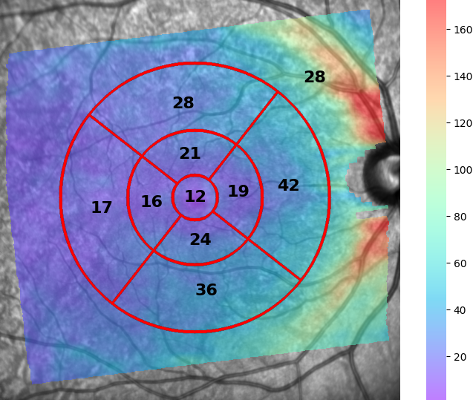
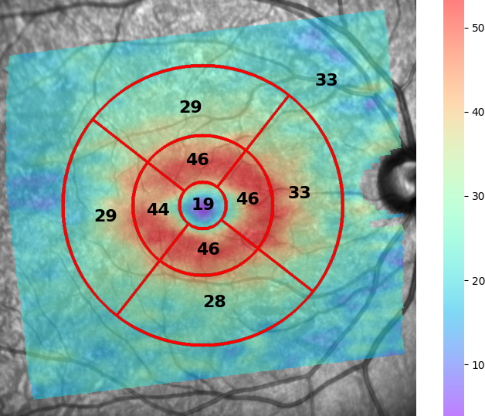
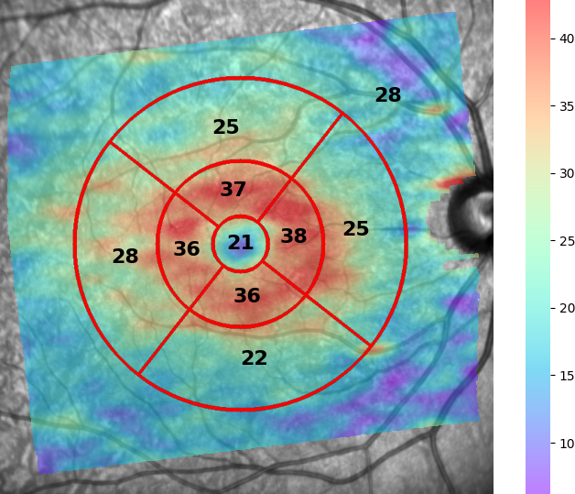
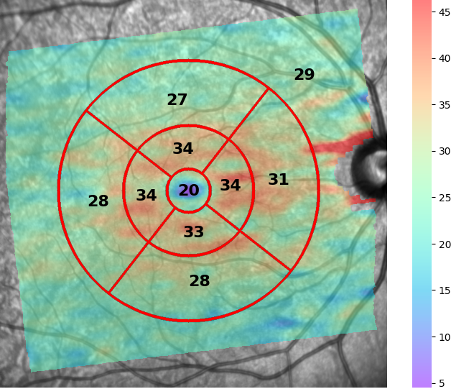
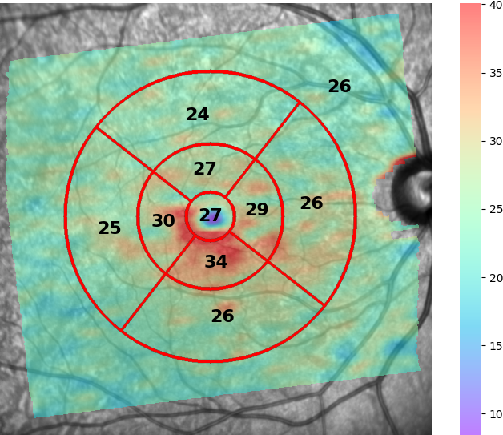
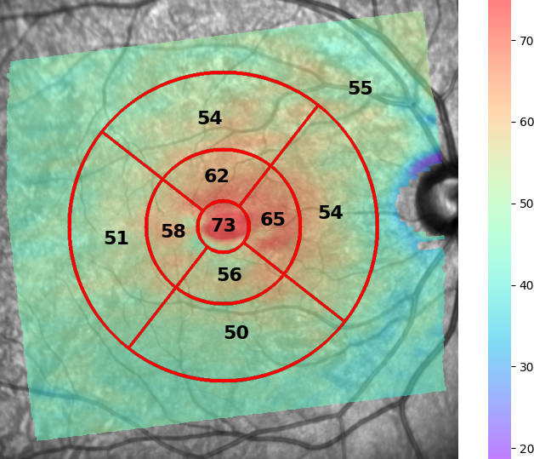
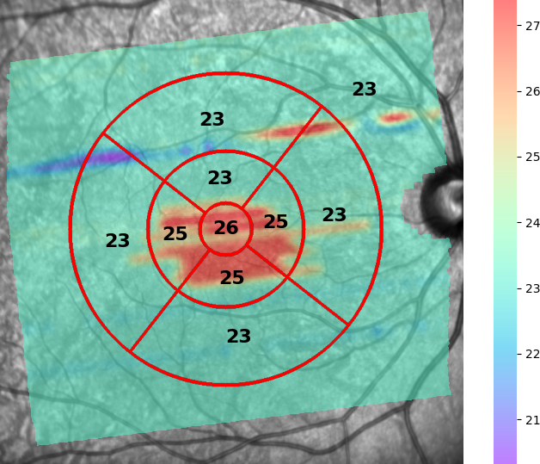
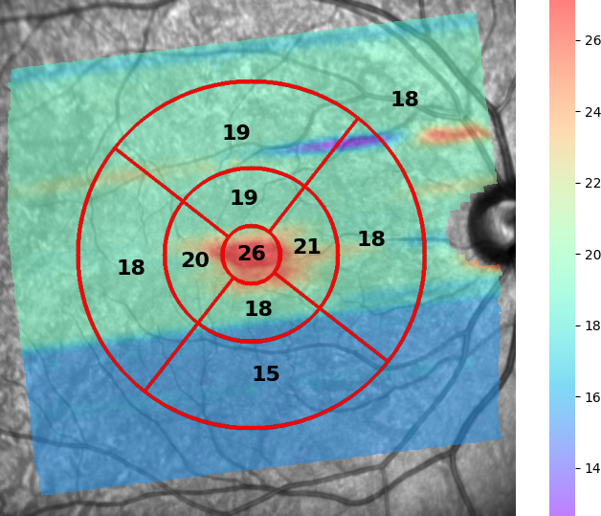
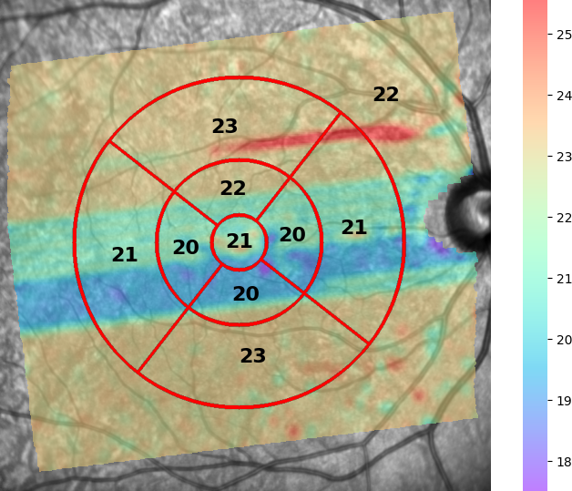
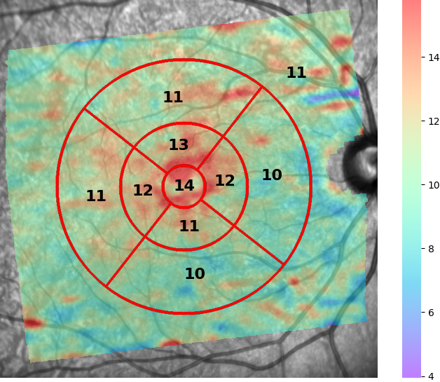
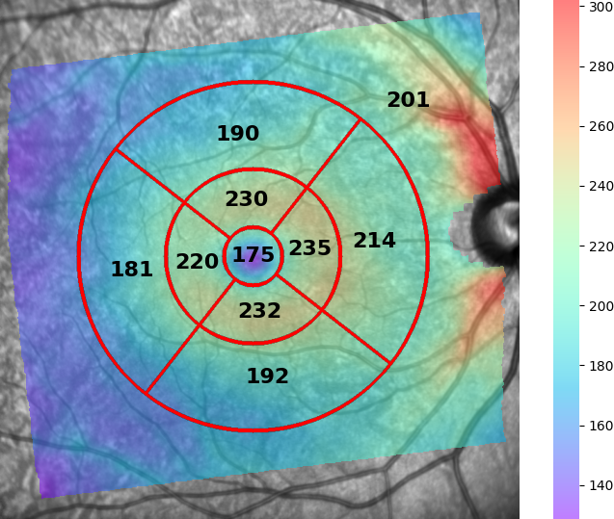
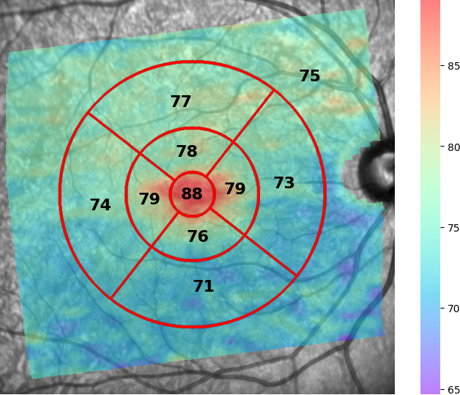
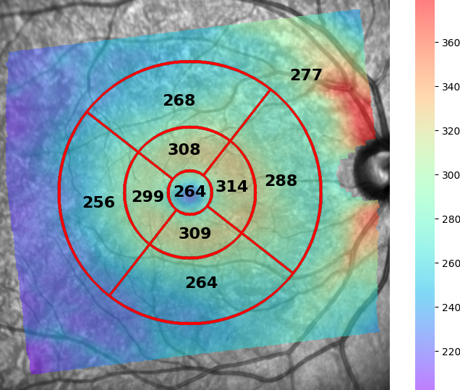
2. Set up configuration file with pipeline parameters
Only relevant for retinal layer thickness map measurement on OCT Volume scans.
custom_maps as comma-separated list of layers separated by underscore, i.e. ILM_IPL, PR1_RPE, GCL_PR2
analyse_all_maps can either be 0 or 1.
Permits all/specific retinal thickness maps to be measured.

Slide 13
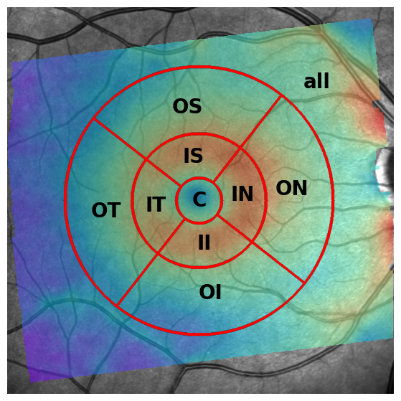
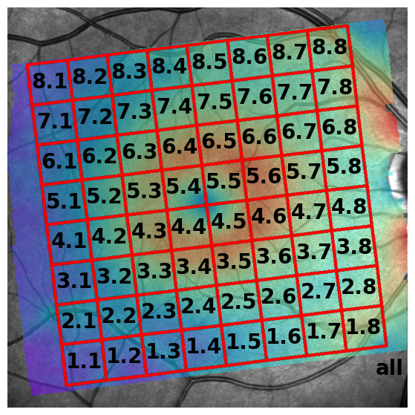
2. Set up configuration file with pipeline parameters
ETDRS grid
8x8 Posterior Pole grid
Only relevant for OCT Volume scans.
Permits analysing the 8x8 posterior pole grid.
The ETDRS grid is used by default

Slide 14
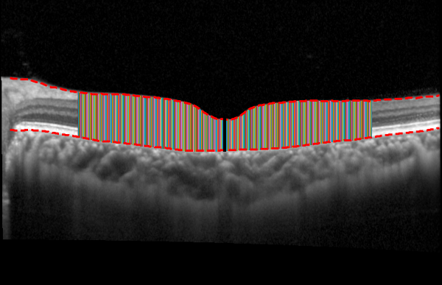
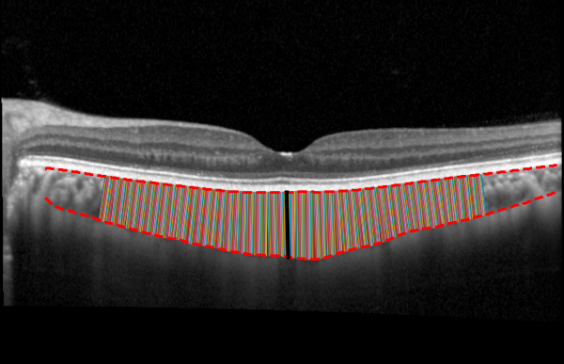
2. Set up configuration file with pipeline parameters
Measuring thickness perpendicularly (according to choroid-axis)
Measuring thickness vertically (according to image-axis)
Specifying how the choroid is measured, i.e. with respect to the image-axis, or choroid-axis.
Options are perpendicular or vertical.
Recommend leaving this as perpendicular.

Slide 15
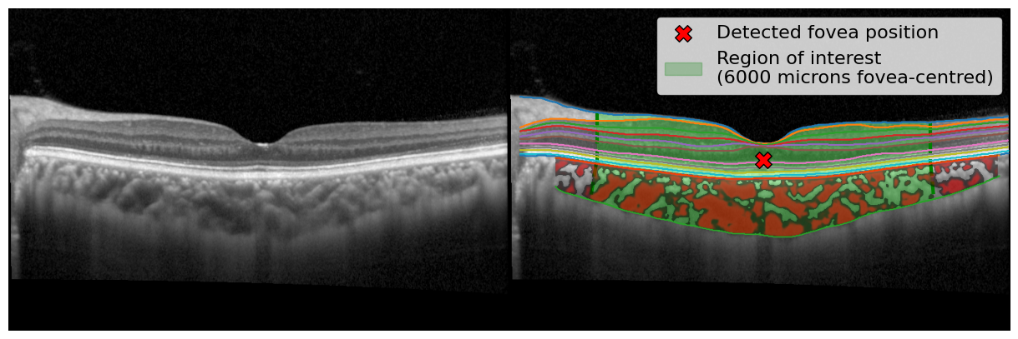
2. Set up configuration file with pipeline parameters
Only relevant for H/V-line scans.
Defines the region of interest (ROI) around fovea in microns.
i.e. 3000 = 3mm either side of fovea.

Slide 16
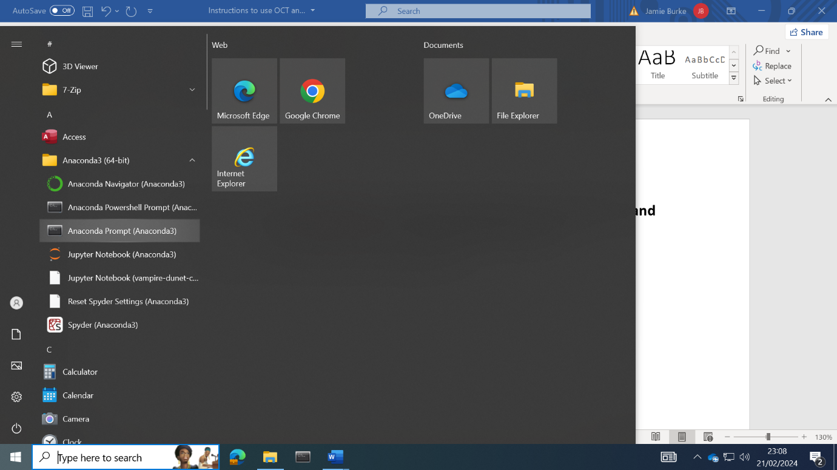

3. Load Anaconda Prompt and run 3 commands:
Launch the Anaconda prompt application (see below)
Select the Windows icon.
Click the drop-down list of the Anaconda3 (64-bit) folder.
Select the Anaconda Prompt (Anaconda3) application.
Type D: and press Enter;
Type conda activate OCT-env and press Enter;
Type python “D:\UoE_SLOOCT_Analysis_Package\2. OCT analysis\OCTolyzer\octolyzer\main.py” and press Enter.
Sit back and relax.

Slide 17
5. Check output
OUTPUT FOLDERS PER PROCESSED FILE
OUTPUT DIRECTORY
METADATA
&
COMPILED
RESULTS
SEGMENTATION VISUALISATION FOLDERS

Slide 18
5. Check output
Firstly, inspect the oct_segmentations and slo_segmentations (if analyse_slo is 1) for segmentation quality (E,F below).
More information and visualisations can be found in each file’s output folder, named {filename} (B,C,D below):
Metadata & measurement xlsx file {filename}_analysis_output.xlsx
Segmentation masks, thickness maps, overlaid segmentations onto the SLO/OCT scans.
Individual log file {filename}_log.txt which prints information on the pipeline’s processing and is useful for checking errors or missing values.

Slide 19
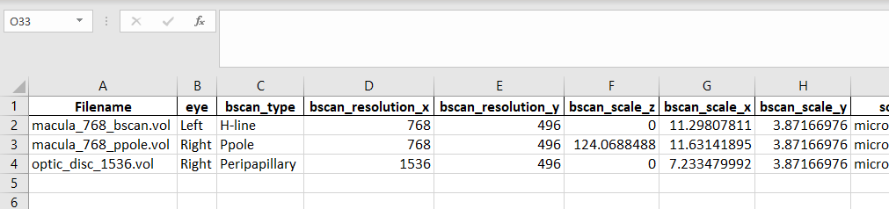
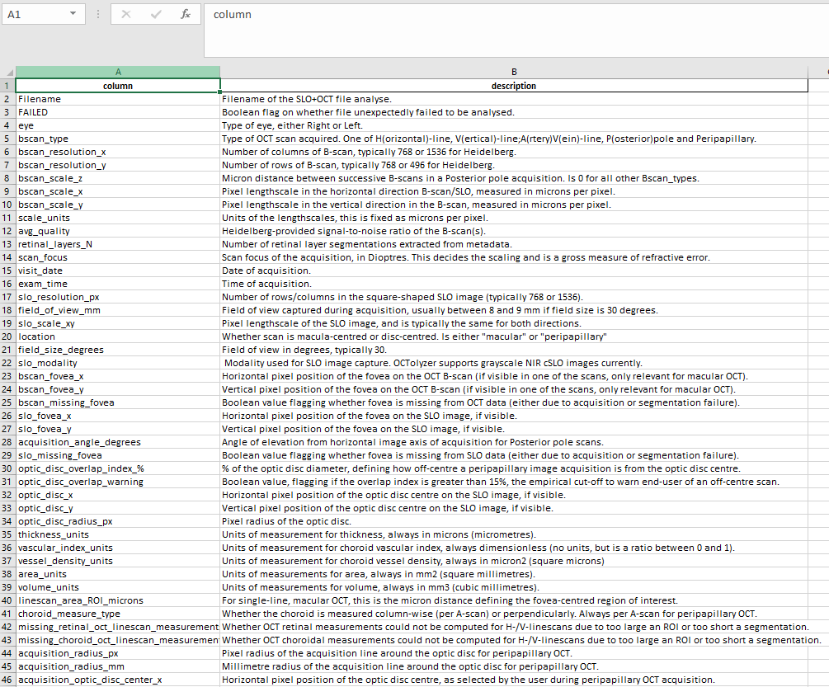
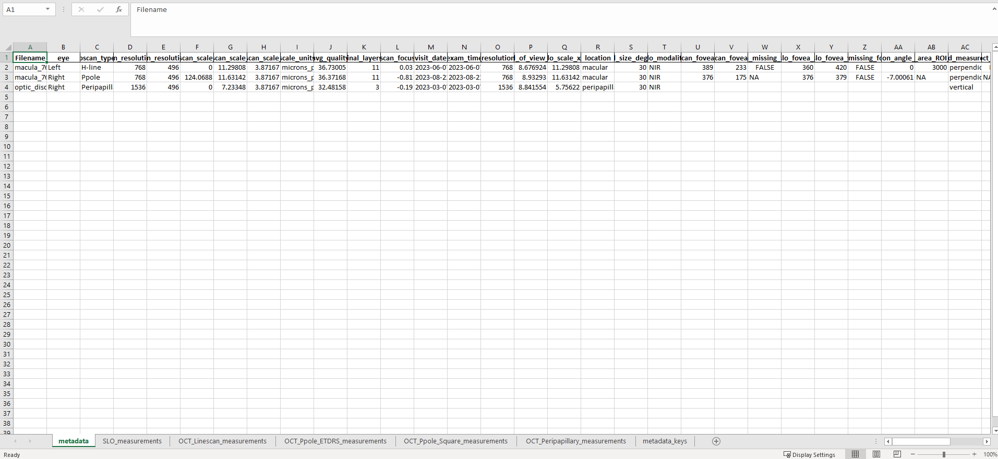
5. Check output
A number of files generated in the output folder:
A copy of the configuration setup used for the batch is saved out to promote reproducibility (A, red arrow).
A log file {filename}_log.txt which prints information on the pipeline’s processing and is useful for checking errors or missing values (A, blue arrow)).
Images of a demonstrative ETDRS grid (and 8x8 posterior pole grid if analyse_square_grid is 1) with codes overlaid for easy look-up on measurement sheet (following Heidelberg’s format) (A, orange arrow)).
The analysis_output.xlsx compiles all metadata and measurements for every file analysed in the input directory (A, green arrow).
There is a metadata_keys sheet in analysis_output.xlsx defining every column heading in the metadata sheet.

Slide 20
5. Check output
Metadata sheet has important information on the success of the pipeline, including the columns with headings:
bscan_missing_fovea: If the choroid segmentation model failed to detect the fovea on the OCT B-scan, this will show TRUE. All measurements will fail as a result, and is mostly only relevant for H/V-line scan.
slo_missing_fovea: If the SLO segmentation model failed to detect the fovea on the SLO image, this will show TRUE.
missing_retinal_oct_linescan_measurements: Unexpected error in OCT retinal layer segmentations (or if bscan_missing_fovea is TRUE) results in measurements as -1s (or removed from sheet entirely), this shows TRUE.
missing_choroid_oct_linescan_measurements: Unexpected error in choroid layer segmentations (or if bscan_missing_fovea is TRUE) results in measurements as -1s (or removed from sheet entirely), this shows TRUE. Could be due to poor segmentation which doesn’t cover entire region of interest specified.
FAILED: If the pipeline had an unexpected error during processing a file, this will show TRUE.
optic_disc_overlap_warning: If the optic_disc_overlap_index_% > 15, this will show TRUE, i.e. the peripapillary scan was off-centre during acquisition by at least 15% of the optic disc diameter.
A separate datasheet “Failed” stores these columns separately for quick look-up of any processing issues OCTolyzer underwent.

Slide 21
FAQs (1/2)
What if my computer crashes mid-run?
The pipeline saves results as it runs, so you can simply carry on where you left off, by launching Anaconda Prompt and running the 3 commands.
What if I need to restart my analysis?
Delete the output folder and re-run the 3 commands.
What if I need to only re-process a single file?
Delete the output folder of that specific file and re-run the 3 commands.
What if I forgot to add another file to a previously processed batch?
Simply add the file to the input directory and re-run the 3 commands. Assuming the output directory is the same as before, all previously processed files will be skipped.
How do I correct SLO segmentation errors?
Instructions are available to use ITK-Snap to correct retinal vessel segmentation.
Can I correct OCT segmentation errors?
Manual correction of OCT choroid/retina segmentations are currently not supported. However, correction of the OCT B-scan fovea is supported currently for H-line/V-line B-scans via ITK-Snap, in the same way as for correcting SLO segmentation maps.

Slide 22
FAQs (2/2)
Why did one of my files fail?
Check the folder’s {filename}_log.txt file for an error traceback. If competent, run the corresponding debugging jupyter notebook on the file, located in OCTolyzer/debugging/check_{scan_type}.ipynb.
Why are there -1s in the measurement results?
Only relevant for H-/V-line scans, and means that the measurements failed due to poor segmentation or too large a region of interest specified. Check the segmentation visualisation in the file’s output folder.
Why are there NAs or empty cells in the metadata sheet of analysis_output.xlsx?
This is because different scan types are being analysed in a single batch, and some columns are only relevant to certain scan types, i.e. linescan_area_ROI_microns is only relevant to H/V-line scans.
Why are the results of some files missing from their excel sheet in analysis_output.xlsx?
This is likely because these files failed to be analysed, check the columns mentioned in slide 20 to see if one of these have been flagged, or the Failed datasheet.
While metadata is saved out for every file, if measurements fail to be computed then they are not stored in the respective measurement sheet.
Why don’t my peripapillary results include measurements on the choroidal vessels?
This is because we use DeepGPET for peripapillary choroid analysis, which only segments the choroid region. This is because we have found DeepGPET to be more successful at peripapillary segmentation than Choroidalyzer.

